Slide 1
ENERGY
TRANSFORMATION
LESSON PLAN
GRADE 4

Slide 2

HOW ARE ENGINEERS AT
WORK IN OUR COMMUNITY?
Notes:
Ask students to identify the forms of energy and transformations (that might be occurring) as you identify which career is represented on the following slides.

Slide 3
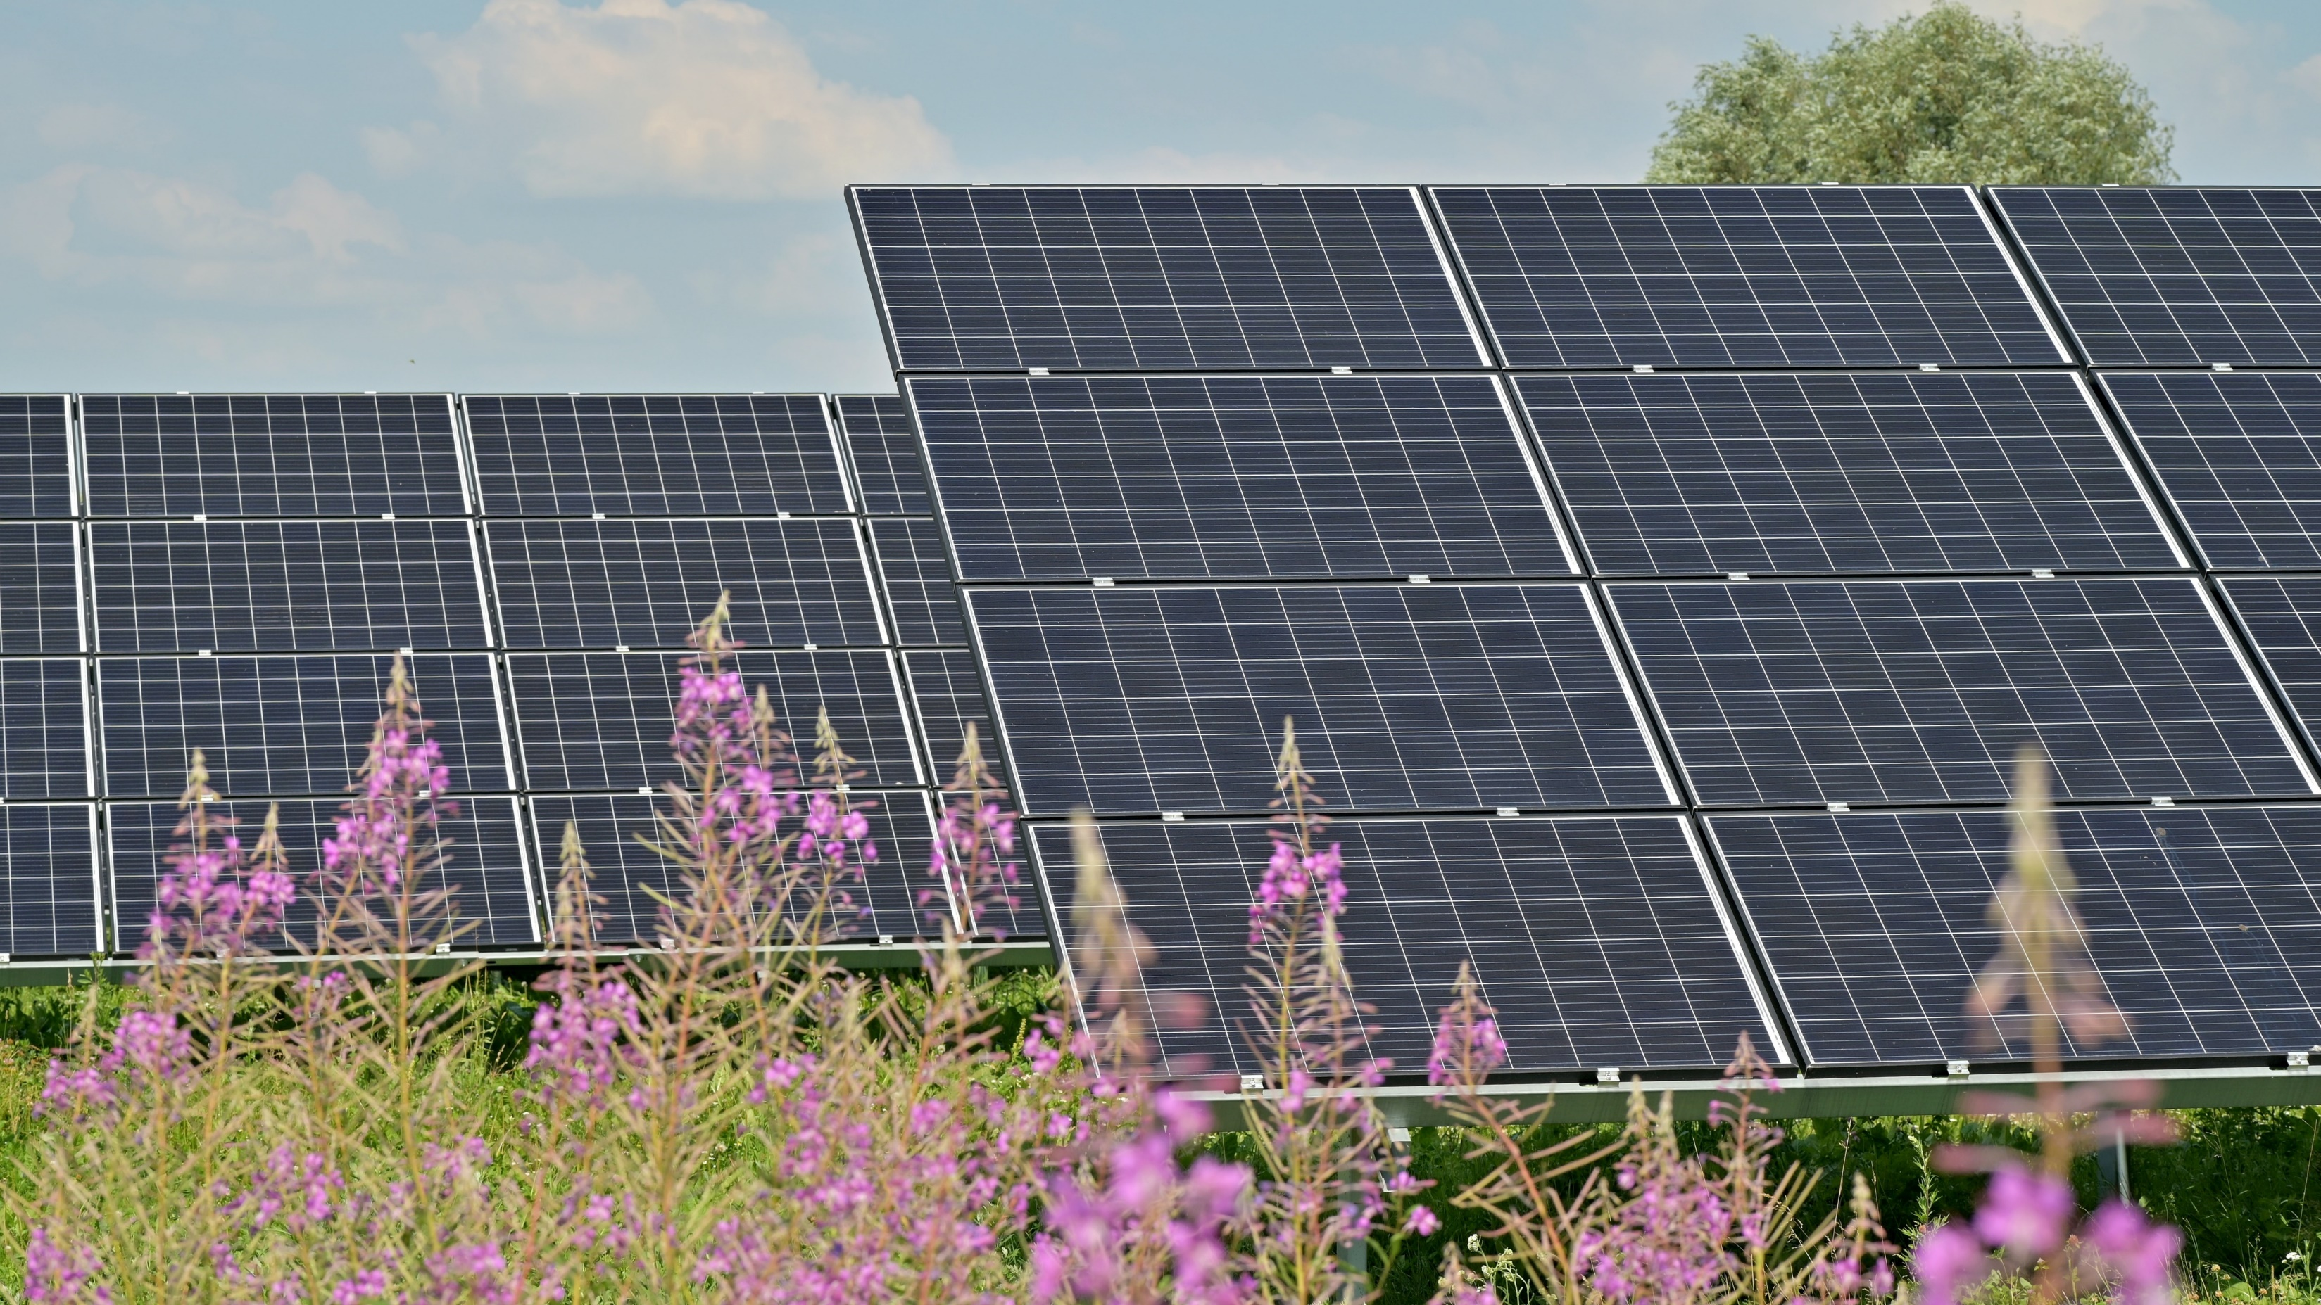
WHAT TYPE OF ENERGY IS
INVOLVED HERE?
Photo by Andres Siimon on Unsplash
Notes:
The Sun’s energy is converted into electrical energy which is then transformed in many devices in our homes, schools, businesses and community.
Engineers design these systems to bring the Sun’s energy to us.

Slide 4

WHERE IS THE ENERGY?
Photo by Sugden Guy sugden on Unsplash
Notes:
Steam trains used energy transformations to move. Coal was burned to create steam, which moved the wheels, also creating smoke and noise.
The first steam engine was invented by an engineer in 1698. Since then, engineers have improved on the designs to make them more efficient in transferring energy to power trains.
Background info: Thomas Savery was an engineer who patented a machine which was powered by steam pressure.

Slide 5

WHAT
ENERGY
FORM
IS BEING TRANSFORMED?
Photo by Sugden Guy sugden on Unsplash
Notes:
The wind turbine blades are turned by wind. The mechanical motion that occurs in the motor creates electricity.
Engineers design and develop wind turbines. They work with testing, production, and maintenance of the wind turbines.

Slide 6
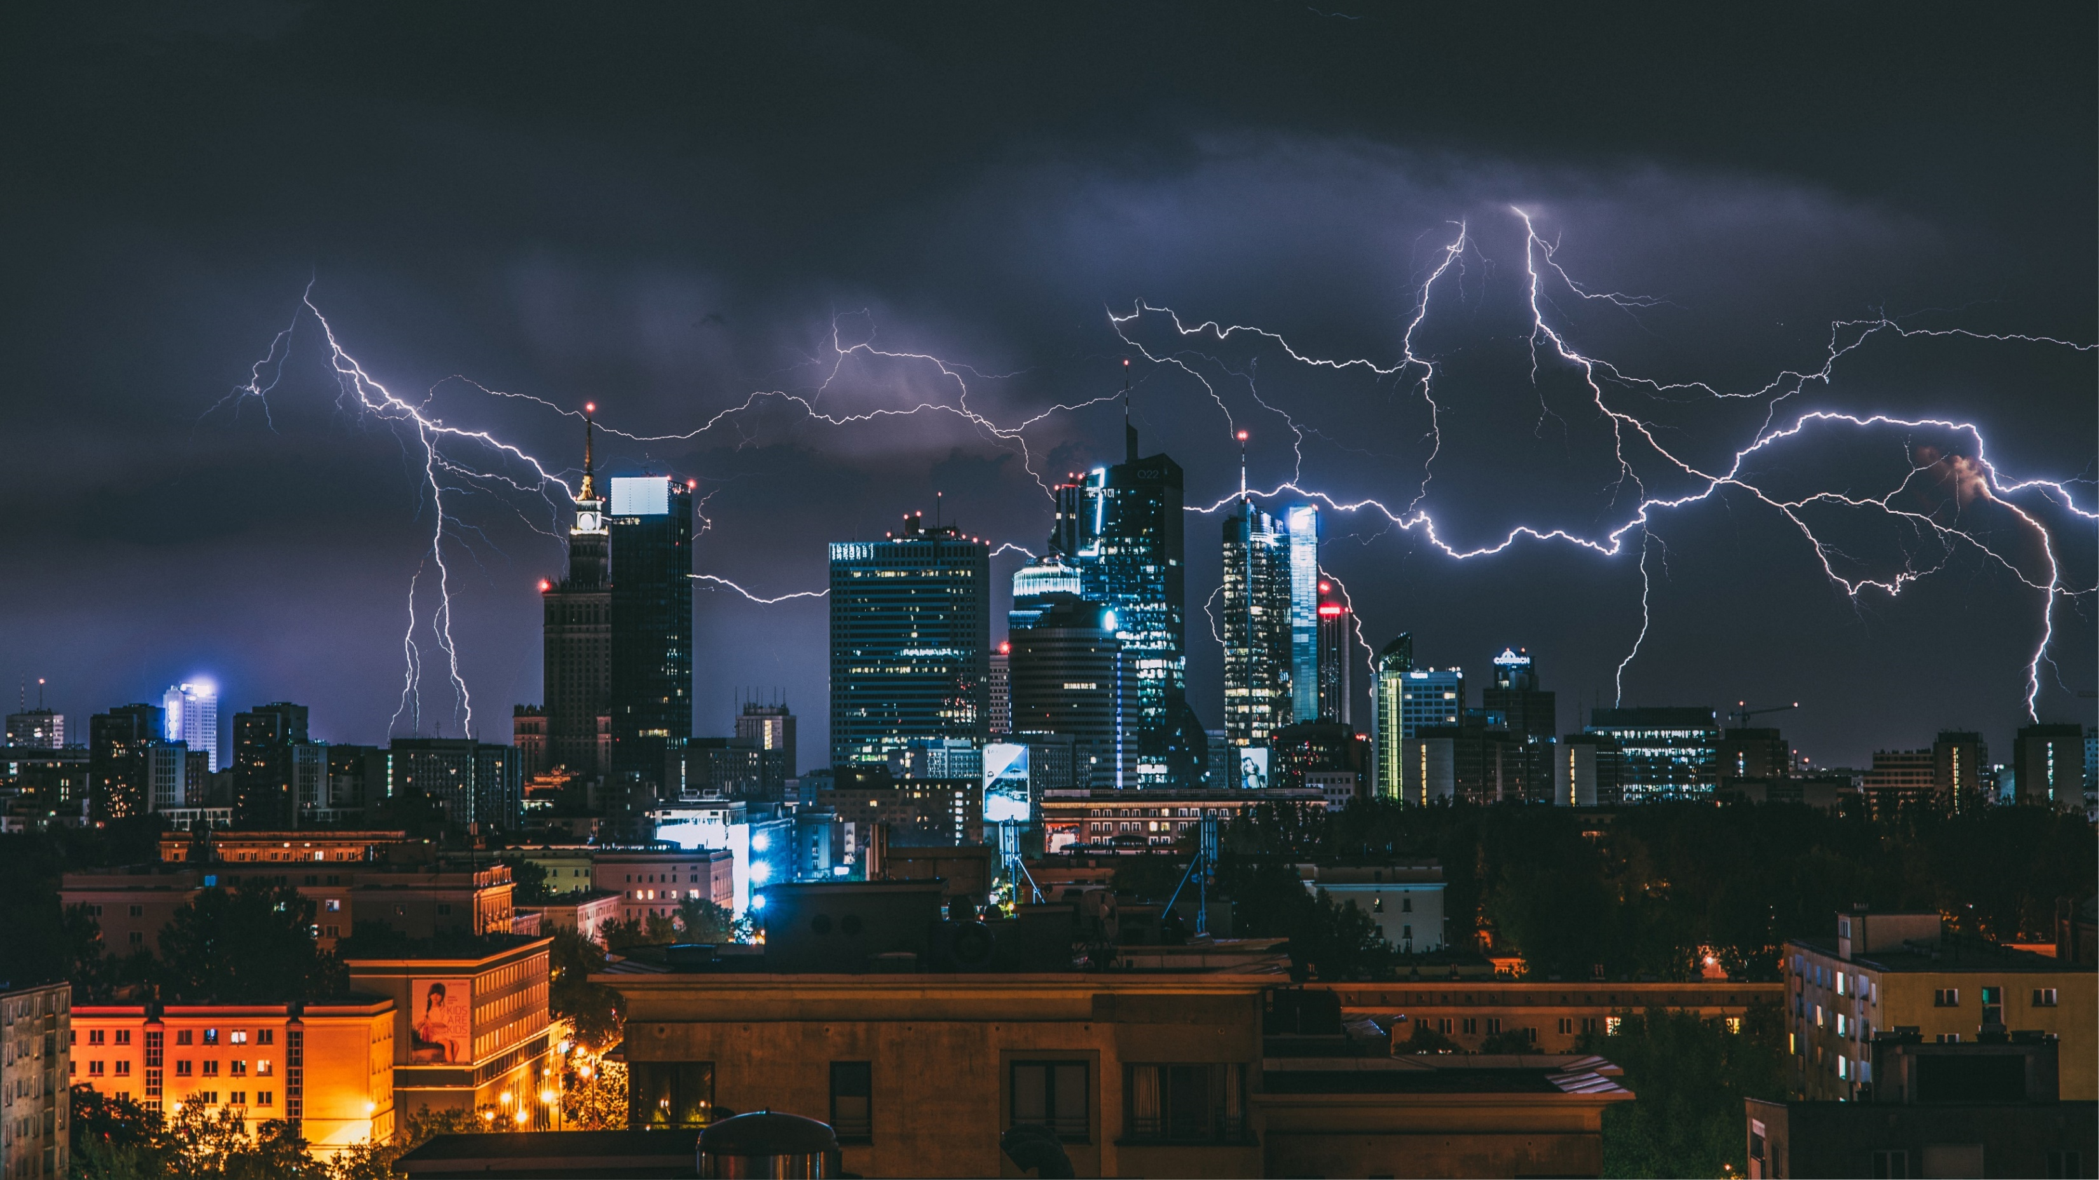
WHERE IS THE ENERGY?
Photo by Krzysztof Kotkowicz on Unsplash
Notes:
Lightning creates light and sound energy. It is a result of energy transformations within clouds.
Engineers who work in lightning protection design buildings in a way so that when lightning strikes a building it travels safely to the ground. This reduces the chance that a fire starts or someone in the building gets hurt.

Slide 7
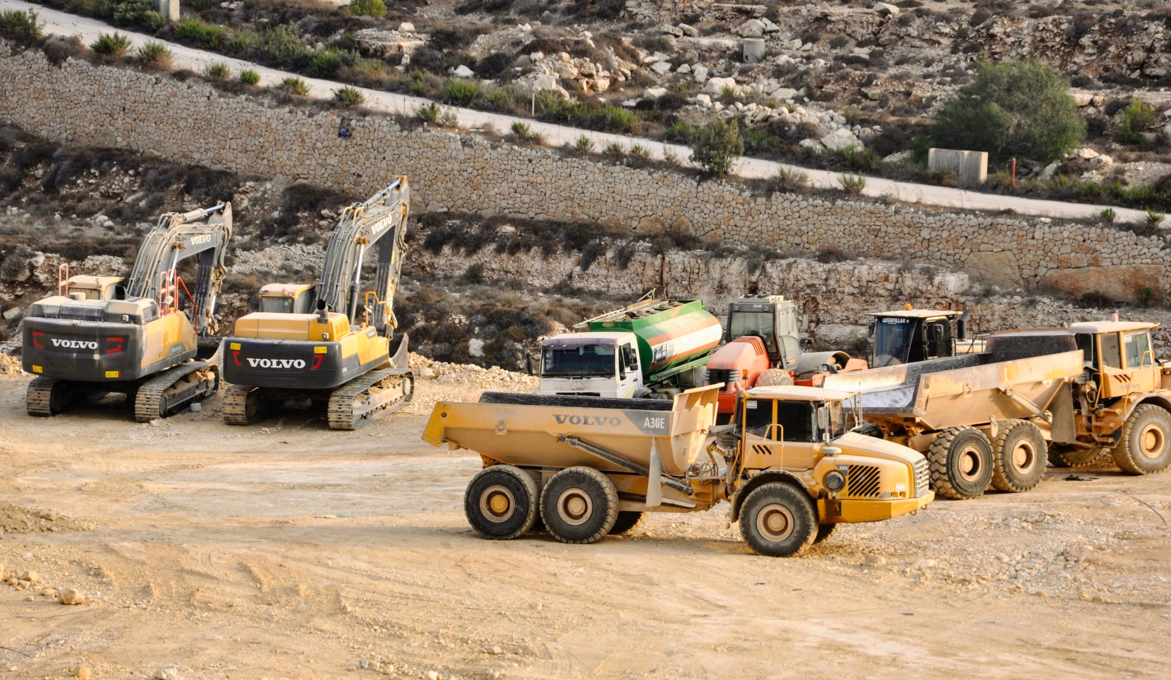
HOW IS ENERGY
USED TO EXTRACT MINERALS
FROM THE EARTH?
Photo by shraga kopstein on Unsplash
Notes:
People need mined materials to construct roads and hospitals, to build automobiles and houses, to make computers and satellites, to generate electricity, and to provide the many other goods and services that we all enjoy everyday.
Geoscientists are Earth scientists. They use their knowledge of the Earth to find out where mineral deposits might be.
Engineers design methods, tools, and technology that can be used to extract minerals and other resources from the ground.

Slide 8

ENERGY TRANSFORMATIONS
Lesson plan provided by
Engineers and Geoscientists BC​
If you have more questions about engineering and geoscience visit
the Engineers and Geoscientists BC website egbc.ca/youth​
Notes:
Engineers and Geoscientists BC is the regulatory body for engineering and geoscience.
If you have more questions about engineering and geoscience visit the Engineers and Geoscientists BC website egbc.ca/youth

