Slide 1
CHANGING
LANDFORMS
OBSERVING EROSION AND DEPOSITION LESSON PLAN
GRADE 3

Slide 2
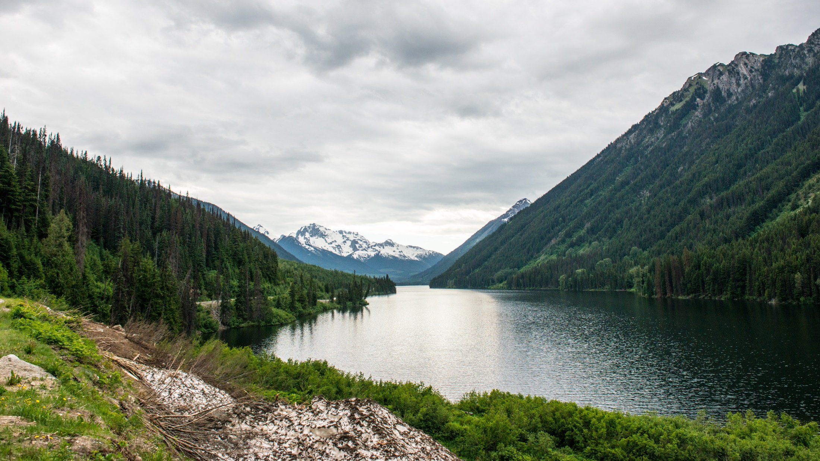
WHAT
HAPPENS
WHEN WATER WASHES THE
SOIL AWAY?
Notes:
During this slide provide students with an overview of the key terms introduced in the activity: erosion, deposition and weathering.
Erosion: This is movement of weathered rock materials from one place to another. Erosion can occur quickly, such as when a landslide occurs. It may occur slowly, over many years. Erosion includes the movement of grains of sand and the movement of gigantic boulders. Erosion can drop materials at any distance from their source—from a few centimetres to hundreds of kilometres away.
Deposition: When eroded rock materials stop moving, they settle on Earth’s surface. This “laying down” of sediments is called deposition. Gravity, wind, water, and ice can all move weathered rock materials to new places; creating new landforms.
Weathering: Weathering is process that slowly breaks down natural materials, such as rocks and boulders, into smaller pieces. Weather includes changing temperature, wind, rainfall, and snowfall. Human-made structures, such as roads and buildings are also weathered. Weathering can be caused by physical forces or by chemical reactions (i.e., acid rain).
Please note: these definitions are also available in the Landforms Essentials section of the Changing Landforms Lesson Plan.

Slide 3
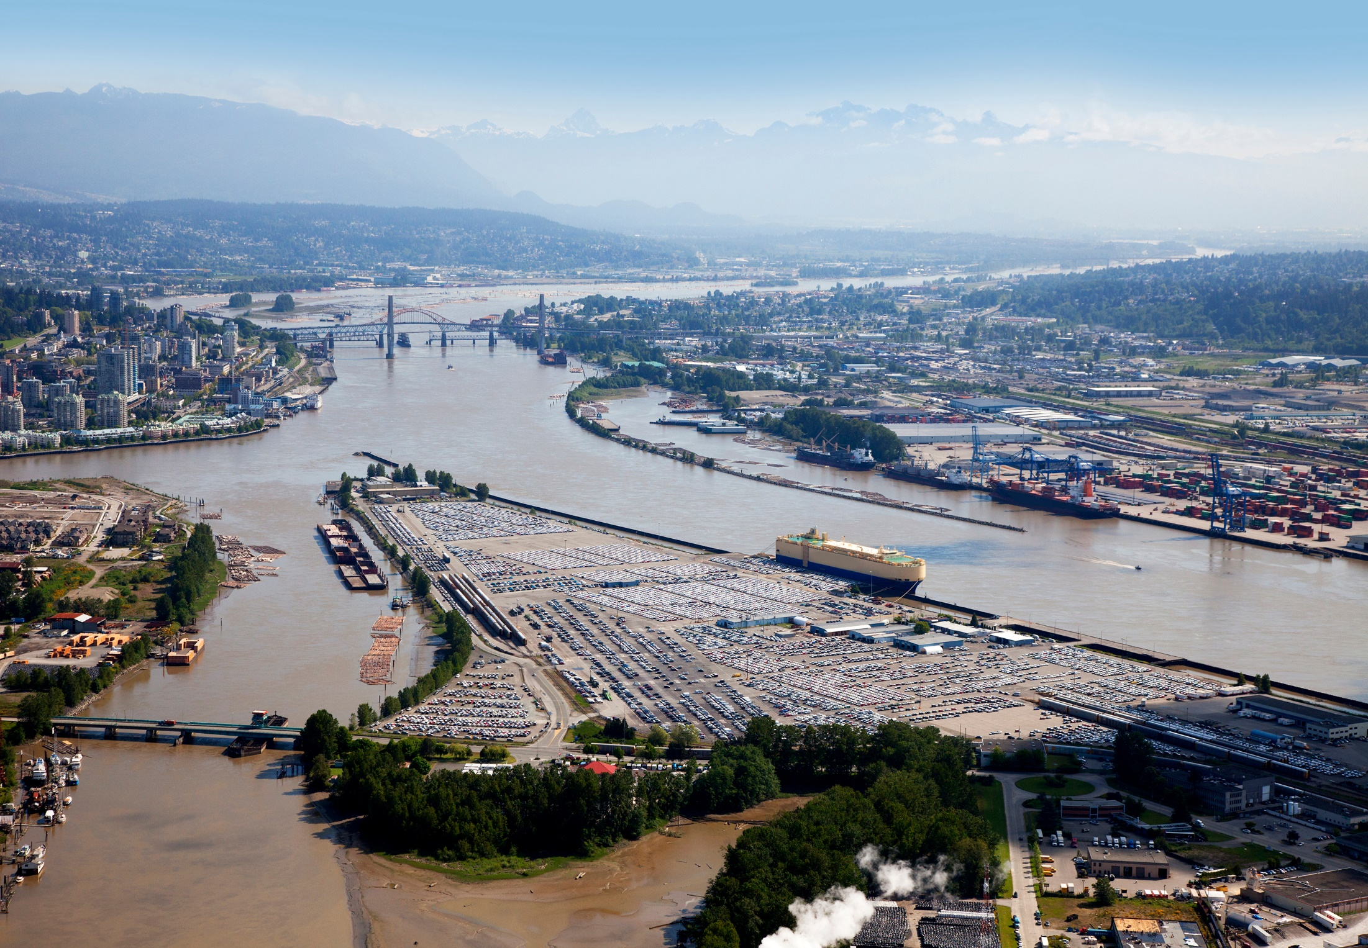
WHAT DO YOU THINK IS HAPPENING
IN THIS PHOTO?
Notes:
The brown colour is evidence that the river is carrying soil particles; a process called erosion. The deltas could be where the soil is deposited. It may also be that the river is weathering the soil, carrying it further downstream (erosion) to where deposition occurs.

Slide 4
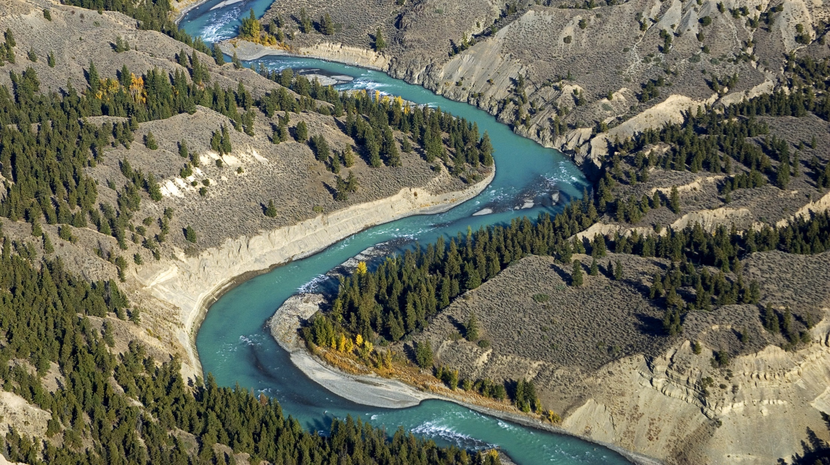
AS THE WATER FLOWS PAST THE RIVERBANKS SOMETHING IS HAPPENING
Notes:
The chalky, blue colour indicates the water is carrying sediment (soil particles).
Weathering occurs through a number of processes:
changing temperature,
wind,
rainfall, and
snowfall.
Human-made structures, such as roads and buildings are also weathered. Weathering can be caused by physical forces or by chemical reactions (i.e., acid rain).

Slide 5
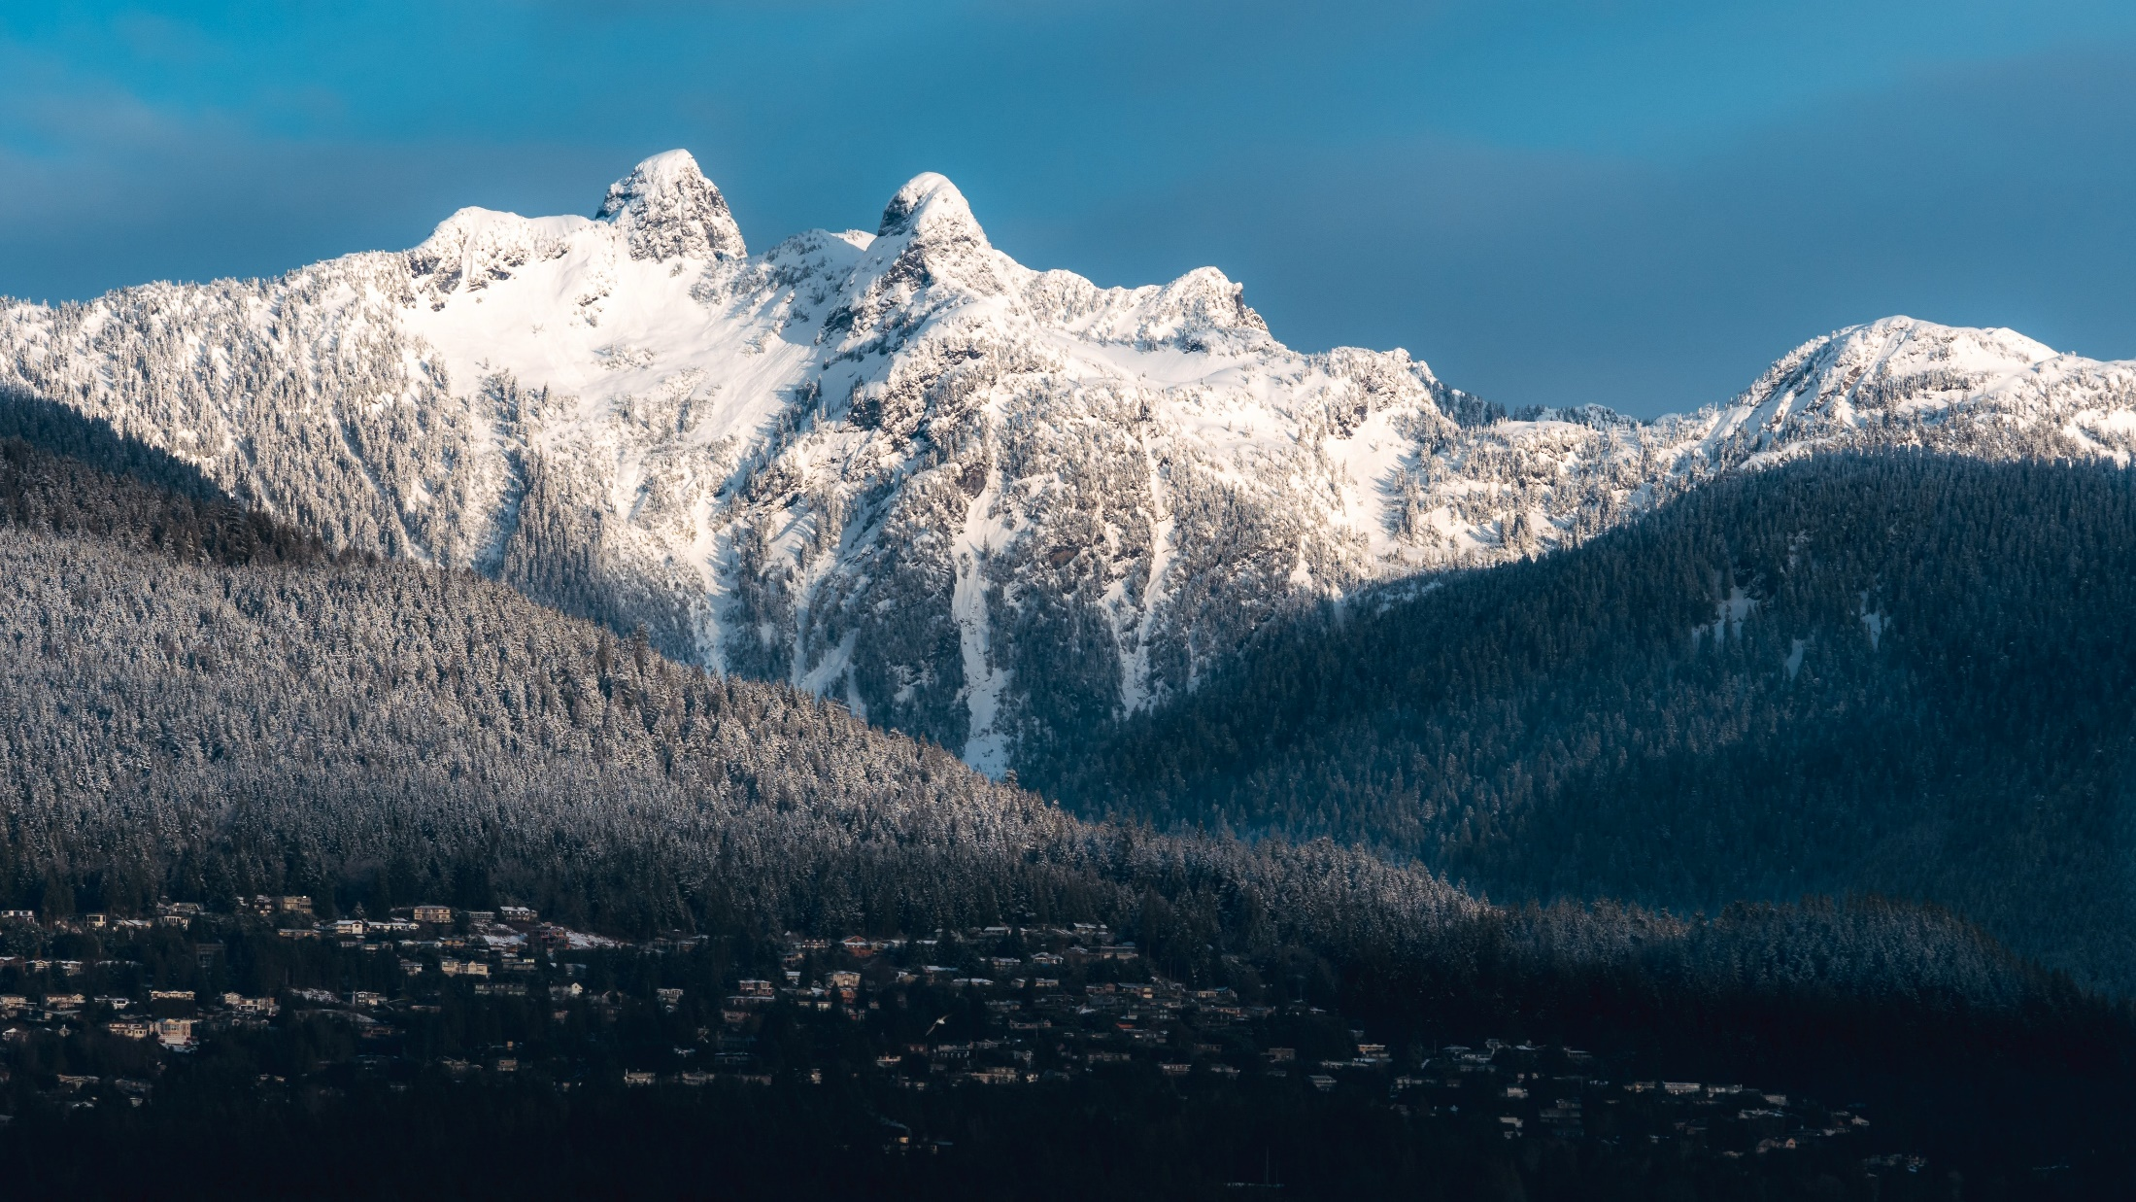
DO YOU KNOW WHAT
THESE ARE CALLED?
Photo by Jack B on Unsplash
Notes:
Ask students if they know what the two peaks at the top of this image are called?
These mountains are referred to by local Indigenous peoples as “The Sisters”. The colonial term for these same peaks is The Lions. Have the students brainstorm how these mountain peaks could have formed.

Slide 6
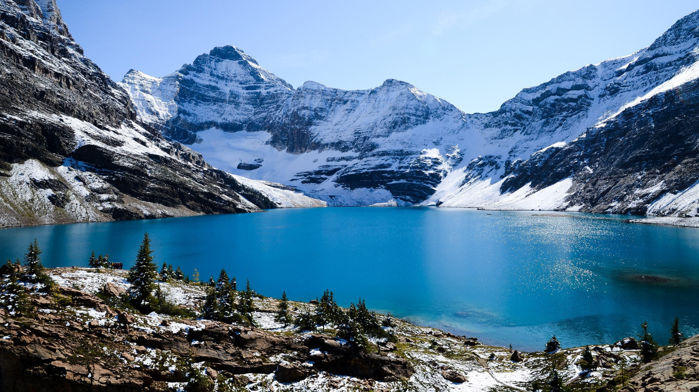
THERE ARE MANY TYPES OF LANDFORMS CREATED BY EROSION AND WEATHERING
Notes:
Over the next few slides ask students to point out where they see any of the geologic processes occurring.

Slide 7
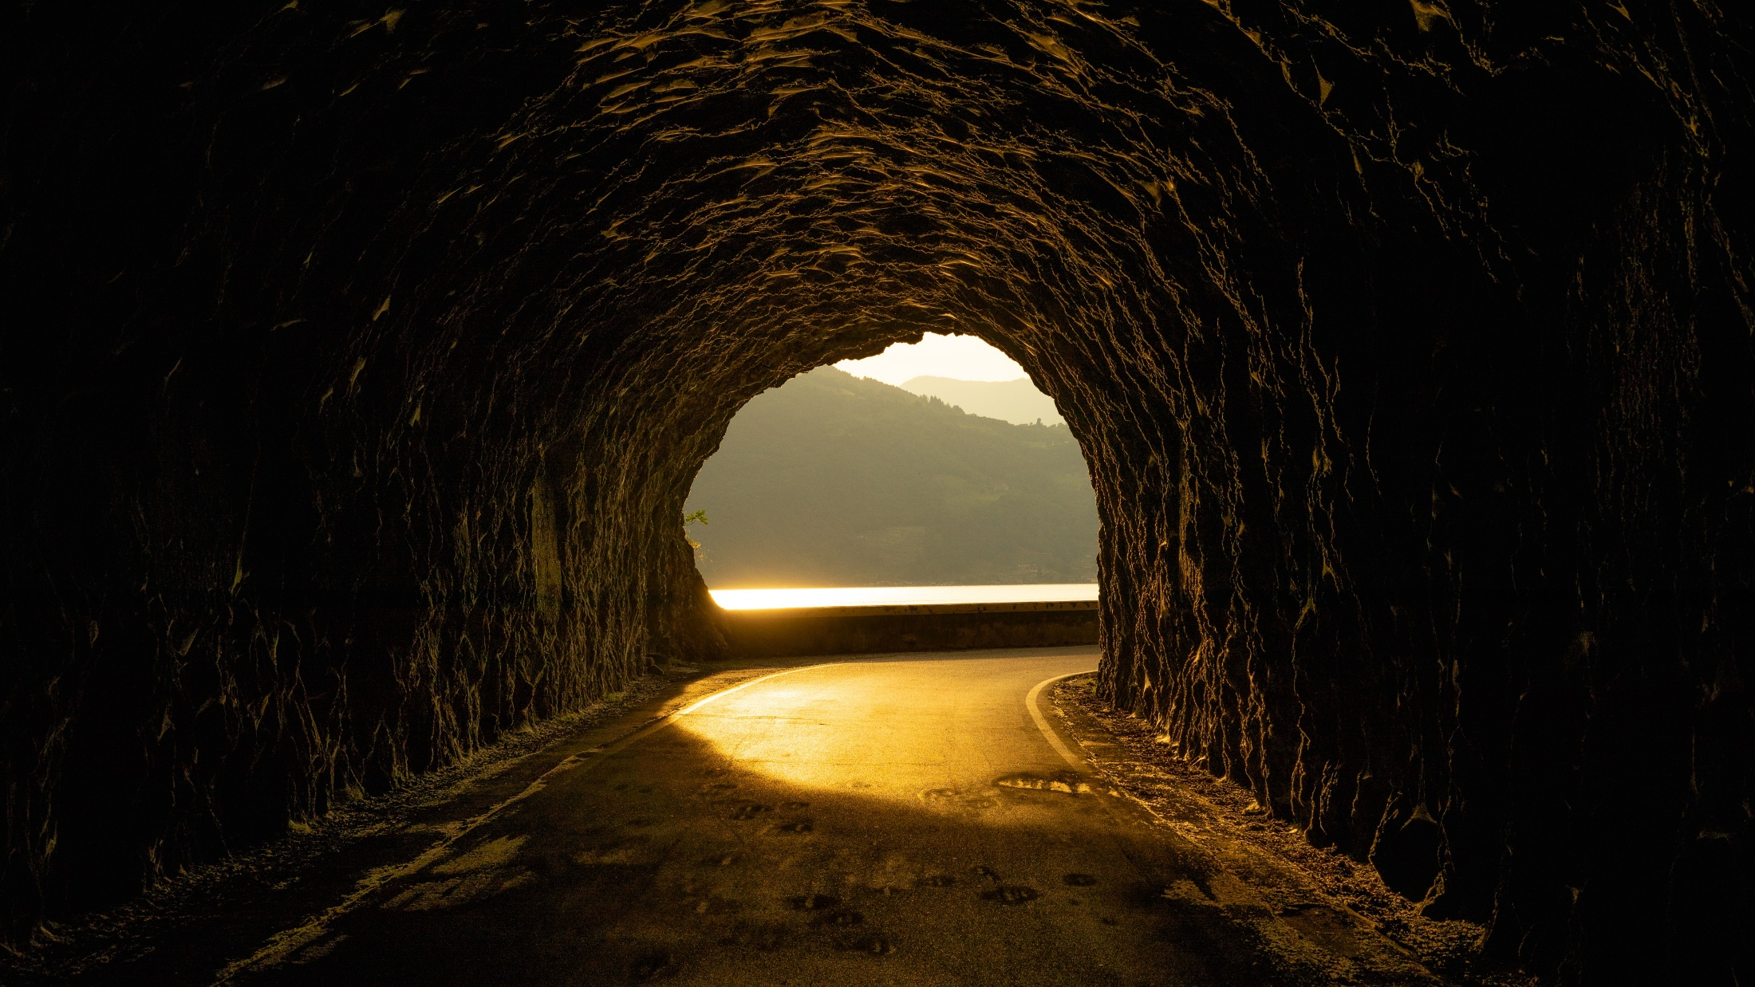
THERE ARE MANY TYPES OF LANDFORMS CREATED BY EROSION AND WEATHERING
Notes:
Ask students to point out where they see any of the geologic processes occurring in this image.
Caves are formed from rocks over millions and millions of years.
Most caves are formed with marble, limestone, dolomite, and gypsum. These are rocks that can dissolve easily over time.
A cave can be formed in many ways including erosion from water, chemical action, tectonic and volcanic forces or pressure.

Slide 8
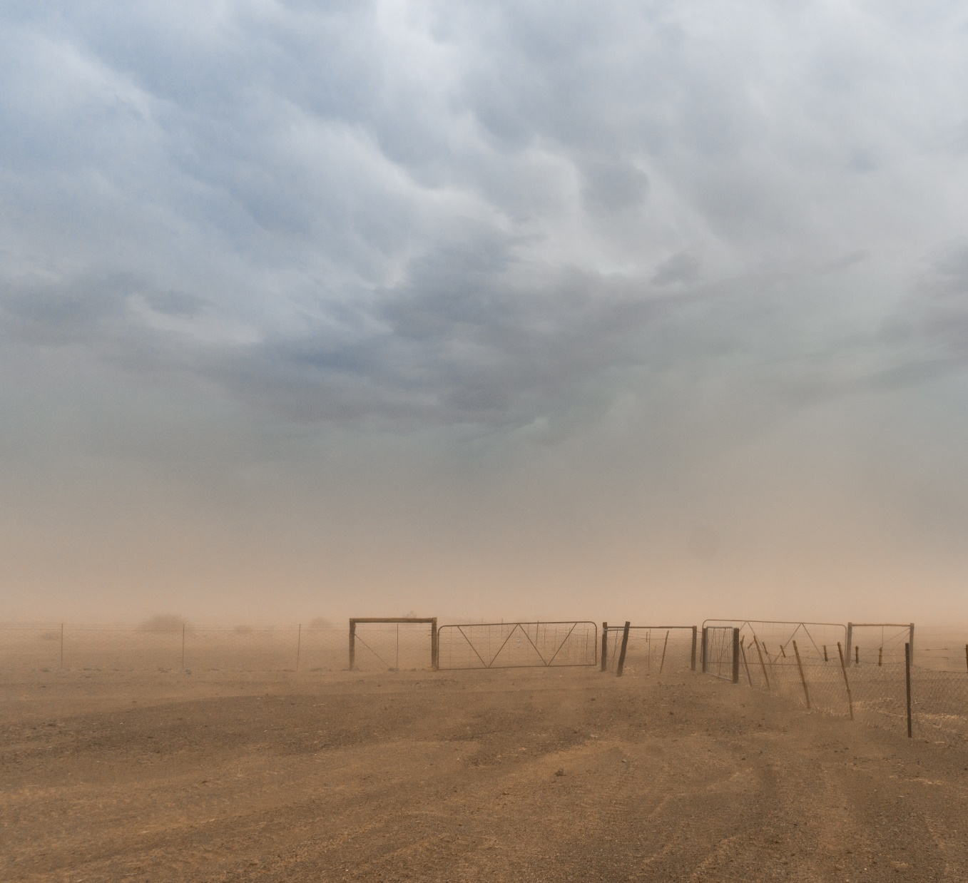
THERE ARE MANY
TYPES OF LANDFORMS CREATED BY EROSION AND WEATHERING
Photo by M. DiFulvio on Unsplash
Notes:
Ask students to point out where they see any of the geologic processes occurring in this image.
Dust storms are a form of wind erosion (the wearing away of something due to the wind).
Dust storms can develop quickly and with little warning in dry places that are prone to long periods without rain.
During a dust storm, the pushed air or wind rushes along the ground picking up light particles of dust, sand, and debris.
The dust storm can cross many miles, making life stand still until the air clears.

Slide 9
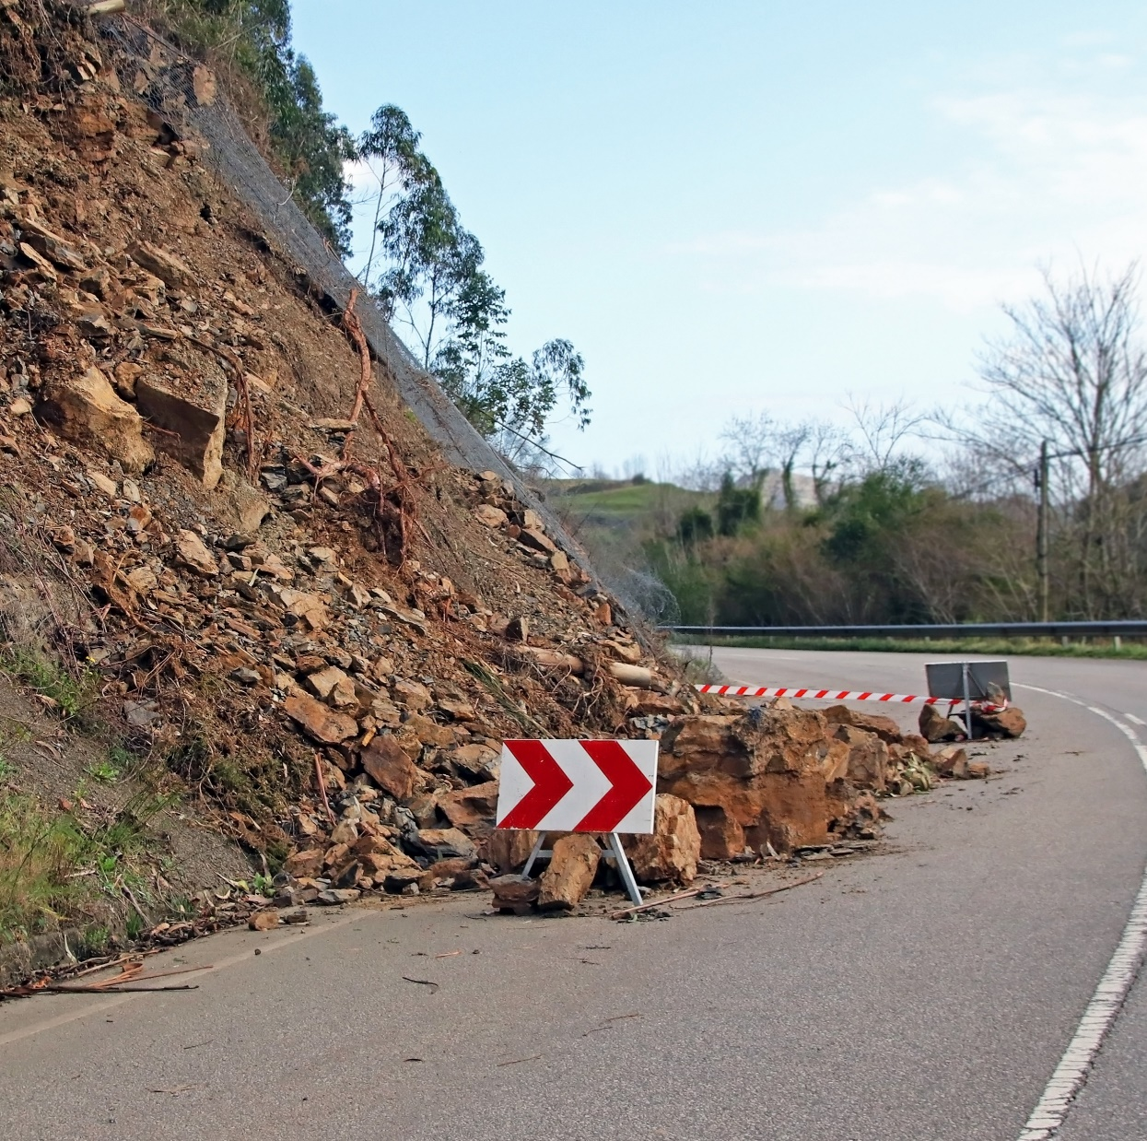
ENGINEERS WORK TO PROTECT COMMUNITIES FROM DIFFERENT TYPES OF ENVIRONMENTAL HAZARDS
Notes:
Ask if anyone has seen something happen on a road or highway due to weather or water; that needed to be fixed.

Slide 10
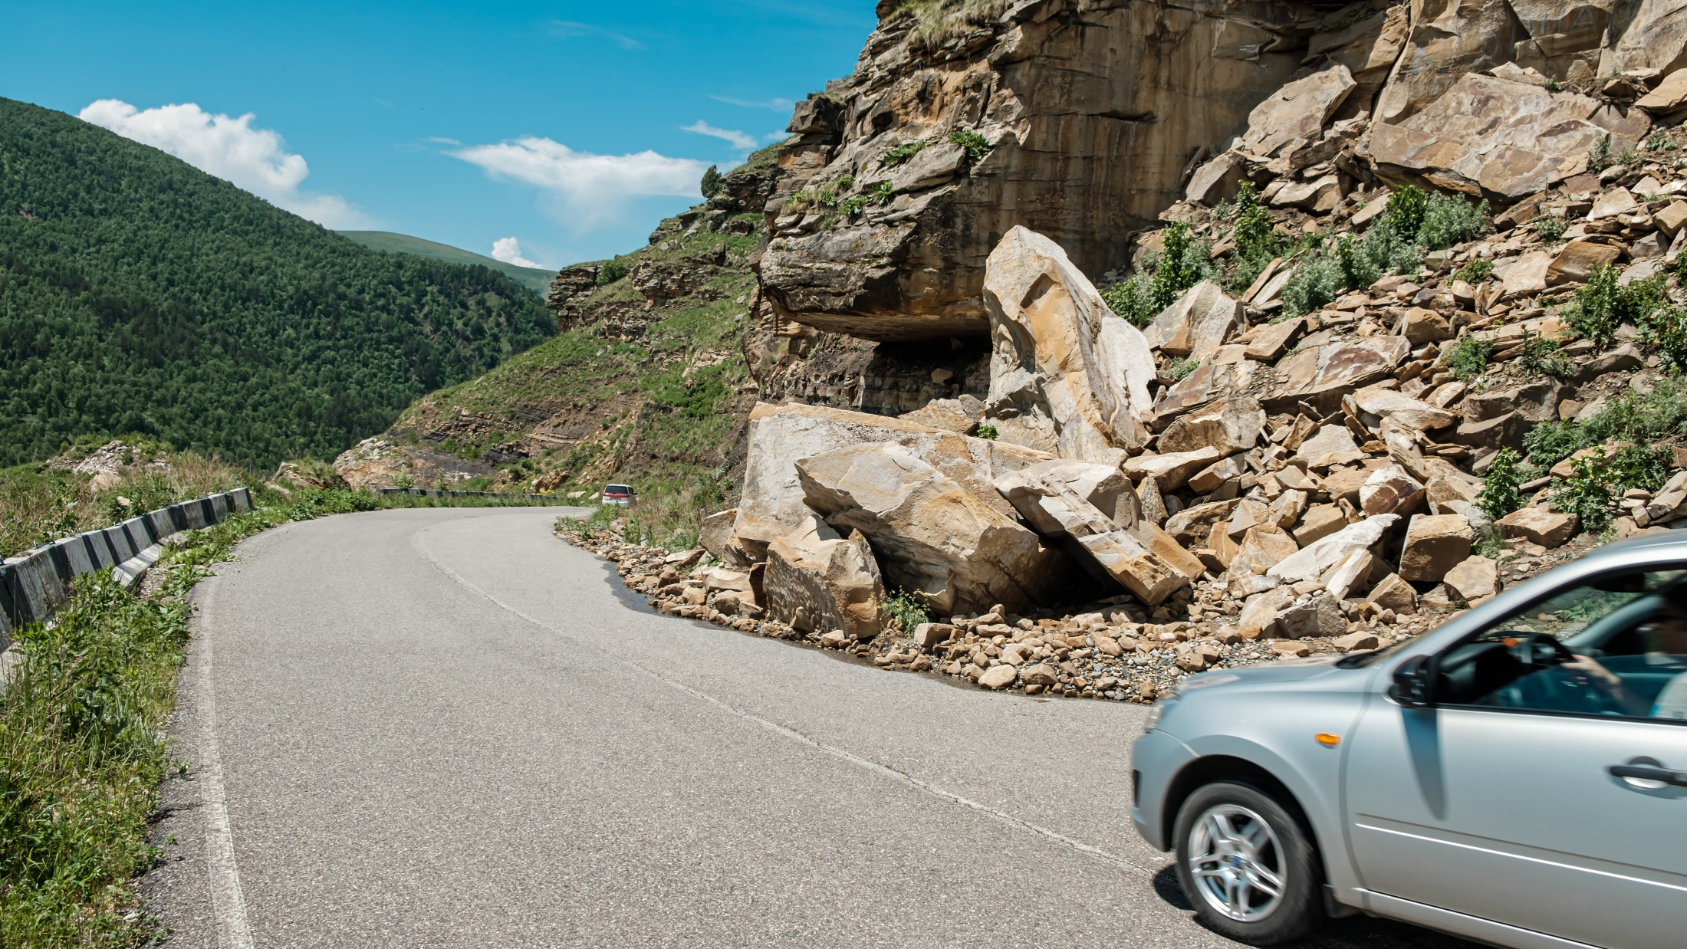
GEOTECHNICAL ENGINEERS
Analyze how soil
interacts with water
Then design ways to
make the soil more stable
Notes:
Ask students what kind of competencies engineers or geoscientists might possess, such as:
Resilience,
Creative thinking,
Problem-solving,
Collaborative attitude, etc.

Slide 11

ENGINEERS MAKE A DIFFERENCE
Lots of different types of engineers
work in our community
They use imagination, creativity, and expertise every day to solve problems and improve the world we live in.
They work with people like architects and doctors to make the world better and help people live healthier and safer lives.
Notes:
Have a student read aloud the text then allow a little time to brainstorm or ask questions about what types of problems engineers might solve in their community.
Pictured: engineering inspecting tanks at a water treatment facility.

Slide 12

CHANGING
LANDFORMS
Lesson plan provided by
Engineers and Geoscientists BC​
If you have more questions about engineering and geoscience visit
the Engineers and Geoscientists BC website egbc.ca/youth​
Notes:
Engineers and Geoscientists BC is the regulatory body for engineering and geoscience.
If you have more questions about engineering and geoscience visit the Engineers and Geoscientists BC website egbc.ca/youth

