Slide 1
Continuing Education
& Annual Reporting
Updated November 5, 2025

Slide 2

Account Dashboard
The Account Dashboard displays all your requirements and deadlines for this calendar year.
It provides easy navigation to resources and reporting systems.
www.egbc.ca/login
Notes:
Registrants can now log into their account and view a dashboard that shows them a personalized checklist of all their regulatory requirements and the status of each requirement.

Slide 3
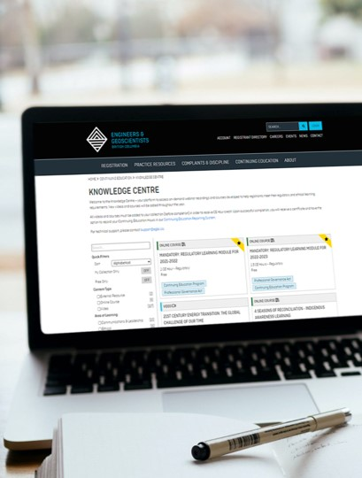
Continuing Education Program
Requirements due by June 30, 2026:
Complete the 2025/26 Regulatory Learning Module
Record 1 CE Hour of ethical learning
Create a CE Plan
Record at least 60 CE Hours of activities over the Three-Year Rolling Period.
www.egbc.ca/continuing-education
Notes:
A reminder of CE requirements this year:
Complete the 2023/2024 Regulatory Learning Module
Record at least 1 hour of Ethical Learning
CE Plan
Must complete 60 CE Hours of activities in each three-year rolling period . The first three-year rolling period will end in June 2024.

Slide 4

Three-Year Rolling Period
Record at least 60 CE Hours of activities between July 1, 2023, and June 30, 2026.
Struct.Eng. must record an additional 60 technical learning CE Hours directly related to their practice.
Professionals first licensed on January 1, 2024, or later will not report 60 CE Hours this year.
Check the Account Dashboard for your specific requirements.
www.egbc.ca/continuing-education

Slide 5

Continuing Education Activities
CE activities do not have to be offered through Engineers and Geoscientists BC to be eligible and can include:
self-directed study,
volunteering,
presentations,
seminars, conferences, courses, and other activities.
www.egbc.ca/continuing-education

Slide 6

Exemptions
Registrants on a professional leave of absence (e.g., parental, medical, or compassionate care) or experiencing similar extenuating circumstances may apply for a CE exemption.
Application deadline: June 30
www.egbc.ca/continuing-education

Slide 7

Annual Reporting
Submit between May 1 and June 30, 2026:
Annual Reporting is the process to verify your contact and practice details, and complete annual declarations.
Completed by all registrants (P.Eng., P.Geo., P.L.Eng., P.L.Geo., EITs, GITs, and Non-practising).
Takes approximately 10 minutes.
www.egbc.ca/annual-reporting
Notes:
Different from Continuing Education, Annual Reporting is the process by which all registrants must update their personal and professional contact information and complete annual declarations.

